Slide 1
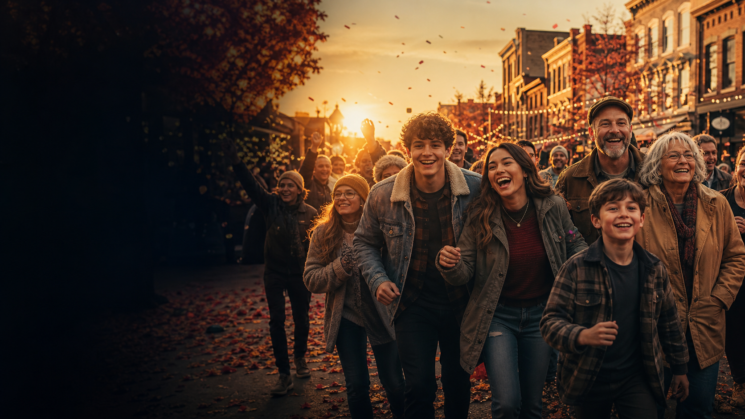
HOME
TEAMS
Canada’s unique communities and neighborhoods go head-to-head in a weekly race to rally the crowd, transform their community—and win the country.
PRESS PLAY · PICK A TOWN · GO
Created by Dan Galea
HOME TEAMS · 01
Notes:
[Sources]
- Cinematic community hero: OpenAI ImageGen, generated for this deck.

Slide 2
Pick your path.
Four quick jumps. One big hometown showdown.
THE HOOK
THE GAME
Why every town will campaign to join.
The five-step engine anyone can get.
THE CAST
THE SALE
Eight archetypes. Infinite chemistry.
Promotable. Sponsorable. Exportable.
HOME TEAMS · STORY MENU

Slide 3
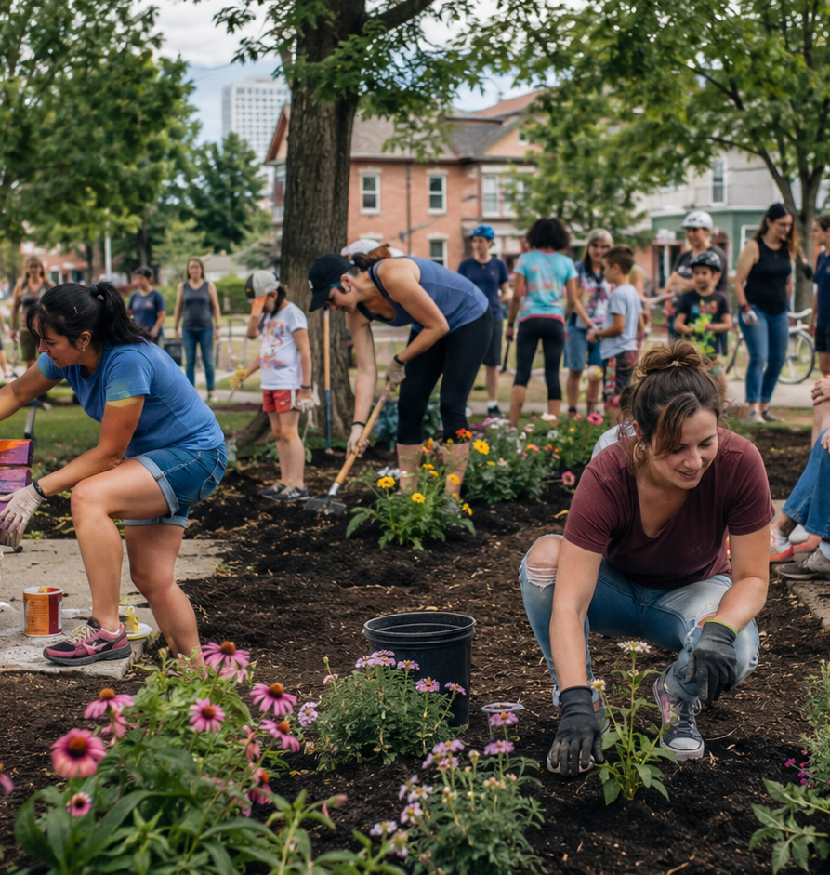
Canada is the playing field.
COMMUNITY IS THE COMPETITION
Towns, neighbourhoods and regions enter as official HOME TEAMS.
Each week, everyone gets the same civic challenge. Rebuild it. Rally them. Paint it. Plant it. Sell it. Celebrate it. Then race to finish the checklist first—and best.
Same mission. Totally local execution. One winner.
HOME TEAMS · 02

Slide 4
Right show. Right now.
BIG HEART. REAL STAKES. ZERO HOMEWORK.
Family-night fuel
Every town campaigns
One clean premise. Every generation gets the stakes.
Local pride turns communities into the marketing machine.
Losing still looks good
Brands belong here
Every team leaves a park, street or local institution better.
Tools, food, travel, banking and telecom fit the action.
HOME TEAMS · 03

Slide 5
The game clicks in ten seconds.
SIGN UP. SHOW UP. OUTDO YOUR NEIGHBOURS.
SIGN UP
GET THE CHALLENGE
RALLY THE TOWN
CHECK IT OFF
WIN BIG
Pitch your town. Make us care.
Same mission. Same checklist. Clock starts.
Residents, schools and businesses swarm the problem.
Judges score speed, impact, creativity and buy-in.
Take the advantage—and the national bragging rights.
Easy to explain. Impossible not to root for.
HOME TEAMS · 04

Slide 6
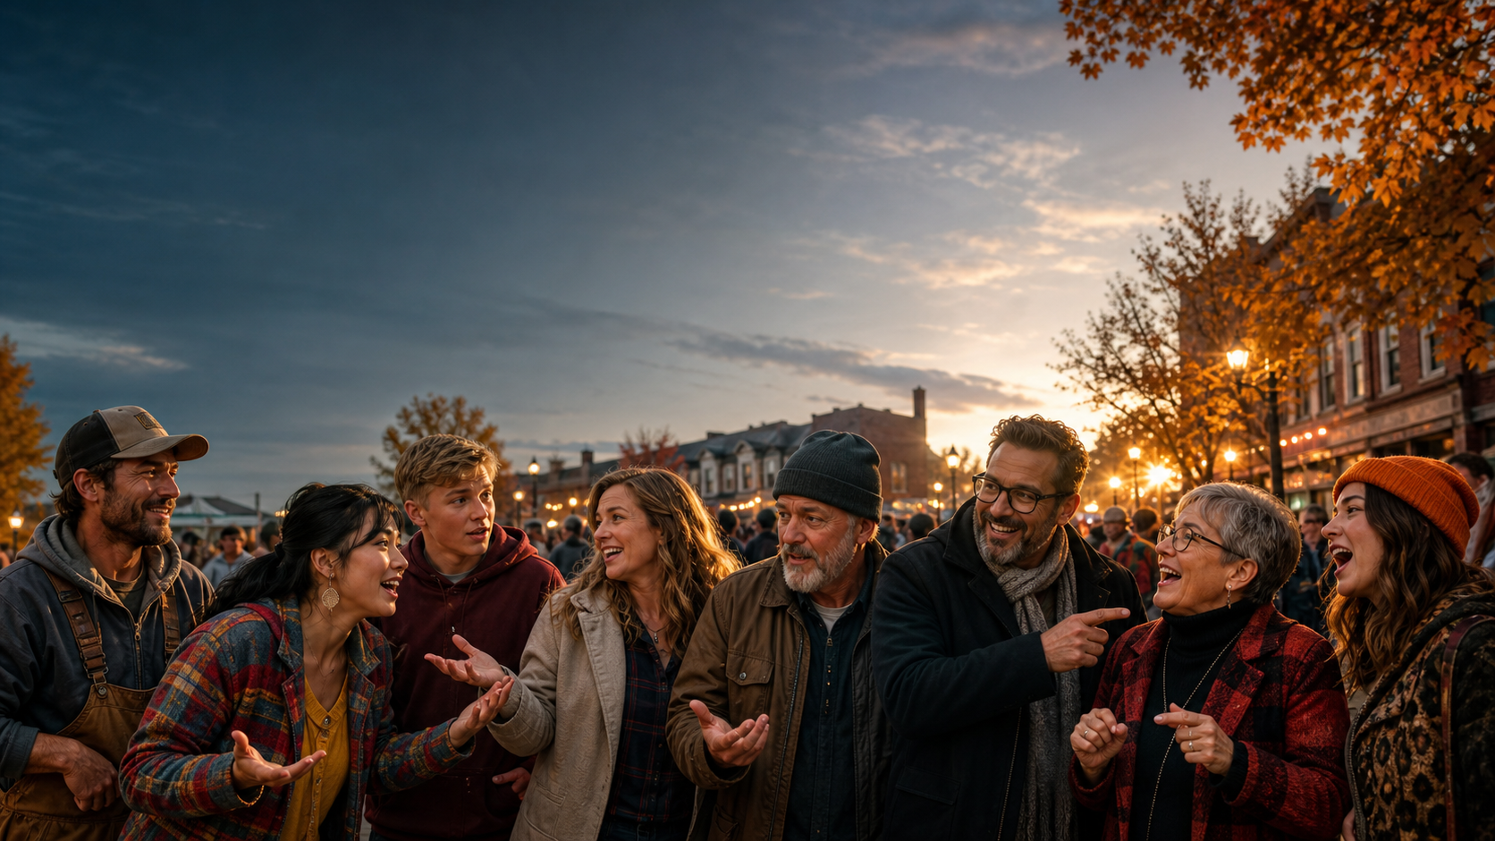
Meet the hometown chaos crew.
THE TOWN BECOMES THE CAST
Ringleader
Local Legend
Teen Truth-Teller
Living Archive
Phone-Tree Wizard
Fix-It Force
Idea Machine
Beautiful Wildcard
Eight archetypes. Infinite chemistry. One town worth rooting for.
HOME TEAMS · 05
Notes:
[Sources]
- Cinematic ensemble cast: OpenAI ImageGen, generated for this deck.

Slide 7
Fair game. Big feelings.
THE CHECKLIST KEEPS THE CHAOS HONEST
HOME TEAM
CHECKLIST
The rules are crystal clear. The way each town meets them is anything but.
✓
Permission secured
✓
Budget disclosed
✓
Volunteer hours logged
✓
Safety signed off
Best time. Biggest heart. Wildest transformation. Smartest use of local talent.
✓
Community served
✓
Before & after documented
HOME TEAMS · 06

Slide 8
Choose your chaos.
SAME MISSION. TOTALLY LOCAL SOLUTION.
RESCUE THE GARDEN
SAVE THE PARK
PAINT THE TOWN
Transform a tired public green space into a gathering place.
Repair, repaint, plant, clean and make it beloved again.
Murals, storefronts, benches, signs — visible civic pride.
FUNDRAISE FAST
MAKE THE AD
WELCOME THE WORLD
Who can rally the biggest total with the most heart?
Sell the town to Canada in 60 unforgettable seconds.
Throw the best local welcome for visitors and newcomers.
HOME TEAMS · 07

Slide 9
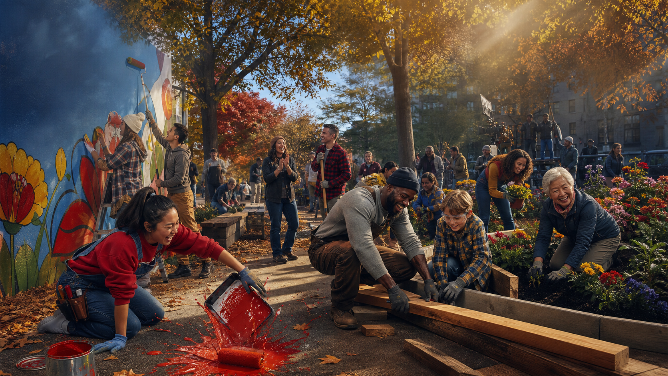
Four ways to win hearts.
CLEAR METRICS. HUMAN JUDGMENT. MAXIMUM DRAMA.
Speed
Impact
Who beat the clock?
Who changed the most lives?
Creativity
Community Buy-In
Who made it unforgettable?
Who got everybody off the couch?
Win the week. Fund the community. Take the bragging rights.
HOME TEAMS · 08
Notes:
[Sources]
- Cinematic challenge action: OpenAI ImageGen, generated for this deck.

Slide 10
Every episode plays like a movie.
NEED. CLOCK. CHAOS. REVEAL. PAYOFF.
1
The Need
A park, garden, shelter or local dream needs help.
2
Challenge Drop
Checklist lands. Clock starts. Pride kicks in.
3
Beautiful Chaos
Obstacles, local legends and hilariously tactical choices.
4
The Reveal
Before/after magic, hard numbers and big emotion.
5
Win + Impact
One team wins. Every town leaves better.
HOME TEAMS · 09

Slide 11
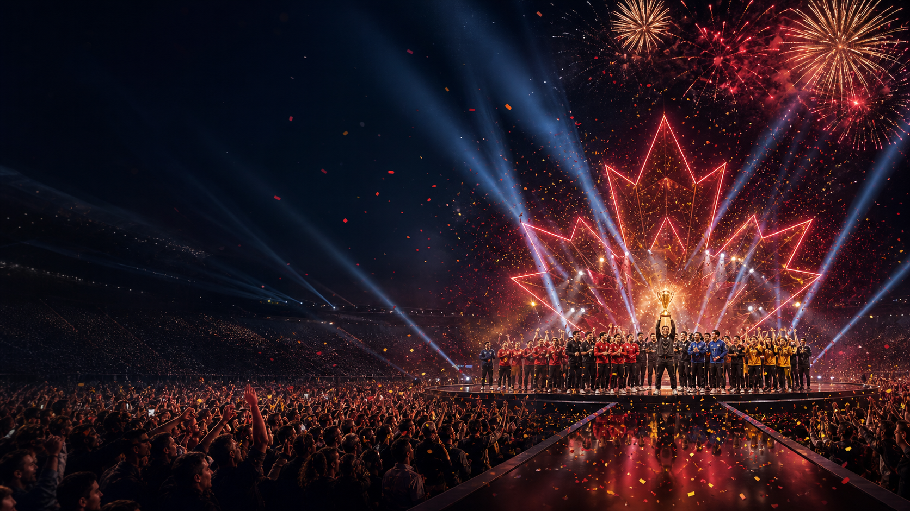
Canada shows up.
THE FINAL HOME TEAM
The strongest communities meet under the lights. Canada sees the transformations, meets the teams and crowns the season champion.
The prize goes straight back into the winning community. Big win. Bigger good.
CANADA VOTES · COMMUNITIES CELEBRATE · ONE HOME TEAM WINS
HOME TEAMS · 10
Notes:
[Sources]
- Cinematic national finale: OpenAI ImageGen, generated for this deck.

Slide 12
Why networks lean in.
Promotable
Castable
Repeatable
Every town becomes part of the campaign.
Real people. Real needs. Endless heroes.
One engine. A season of fresh challenges.
Shareable
Sponsorable
Exportable
Before/after reveals are born social clips.
Brand integrations belong in the action.
Canada first. Then the format travels.
The dopamine of a win. The comfort of a good deed. The scale of a national event.
HOME TEAMS · 11

Slide 13
HOME
TEAMS
EVERY TOWN THINKS IT’S SPECIAL.
TIME TO PROVE IT.
A high-heart, high-stakes competition where doing good is the game.
YOUR TOWN. YOUR TEAM. YOUR SHOT.
Created by Dan Galea
HOME TEAMS · 12
Notes:
[Sources]
- Cinematic community hero: OpenAI ImageGen, generated for this deck.

